Slide 1
PING PONG 2D GAME
COURSE INCHARGE :
DR. HUMERA BASHIR
MADE BY :
ABDULLAH MUJTABA KHAN (B-20102008)
TAHA AKBAR (B-20102176)

Slide 2
INTRODUCTION :
Ping Pong game is just like squash but in this we have one player which controls the square shaped box and in other side, there is a wall on which the square shaped ball bounces back and returns to player and the score increment by one. If a player doesnot touch the ball with square shaped box then the games over and the final score comes to the screen. In between, a player can also pause the game. The background colour changes after every touch by the player. The player controls the box by mouse.

Slide 3
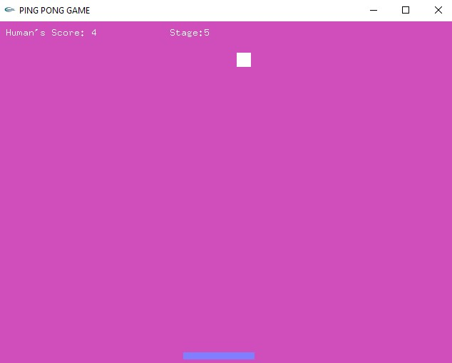
Output :

Slide 4
LIBRARIES:
#include <Windows.h> => declares the basic window operations and functions
#include <glut.h> => intializes opengl in visual studio
#include <iostream> => intializes basic input/output functions
#include <sstream> => to read string as cin, we use string stream
#include <string> => to use string in our program
#include <random> => to use random function in our program
#include <time.h> => for manupulating date and time

Slide 5
INTIALIZATIONS
We have initialize windows width and height: 640x480 and then initializer player score,stage,speed by 0. Background color starting with black, and taken two bool type game over and pause as false and initial counter as 0.
We have defined point Class that gives us x and y coordinates we use here struct instead of class because struct is by defualt public. and in class we need to have used setters and getters functions So keep things easy as possible we use struct.

Slide 6
RECTANGULAR BAR AND BOUNCY BALL
// Player's rectangle bar
Point r1 = { 0.0,5.0 };
Point r2 = { 100.0, 15.0 };
r1 and r2 defines one corner of rectangular bar and r2 defines oppositte corner
// The bouncing square, outside boundary
Point s1 = { 600.0, 400.0 };
Point s2 = { 620.0 , 420.0 };
s1 represent the top-left corner of a square and s2 likely represents the bottom-right corner of the same square, specifying its size and position relative to s1.

Slide 7
FUNCTIONS INITIALIZATION
void init();
void display();
std::string score(std::string s, unsigned int score); => returns the string with score concatenated
void passiveMotion(int x, int y); => this function is activated when mouse moves without any button held.
void moveSquare(); => move the ball every frame
void specialKeys(int key, int x, int y); => handles special keys for restart
void pauseKey(unsigned char key, int x, int y); => handles normal keys
void Restart();
void ChangeToRandomColor(); => changes color value r g b which handles background color

Slide 8
MAIN FUNCTION();
Inside main function we have used all the functions that have been defined along with their parameters, here we have used glutIdleFunc(moveSquare); specially so that square box ball continues to move without anycallback
Then we set displaymode, window size which is as window_height and window_widht, window-position, glutkeyboard(); function to pause the game and glutspecialkey(); to restart the game and in the end use glutmainloop(); so the game continues to run.

Slide 9
Void pause() and Void Specialkey();
void pause takes three arguments that includes escape key to pause and int x , int y to save current position of box. after pressing esc key the bool pause will be true and the game will be paused.
void specialkey also takes three arguments that includes f1 key to restart and int x , int y to save current position of box. in this function we need gameOver bool data type which was previously set to false after pressing f1 it should be true and game restarts.

Slide 10
Void Restart() and Void String Score()
This is the function used to restore all starting values of the game it takes no parameter and the game will start from beginning with black background color.
It is creating string object then it is taking numerical score values from the game and then appending to the string object convert all numerical values to string and store in str. In other words it is overloading function.

Slide 11
draw_ball() and displayfunction();
we are giving coordinates of the box ball to be drawn on screen as you know the s1x&y and s2x&y was previously defined.
In this displayfunction() rectangle bar was drawed on screen as you know the r1 x&y and r2 x&y was previously defined.

Slide 12
Headings
glColor3f(1.0, 1.0, 1.0);
glRasterPos2f(10, 460);
std::string human = score("Human's Score: ", player_score);
for (unsigned int i = 0; i < human.length(); i++) {
glutBitmapCharacter(GLUT_BITMAP_8_BY_13, human[i]);
}
This code is defining the default color of human score heading which was black and defining the rasterpos2f as this is pixel based heading thats why to define its position we use rasterpos2f, and to describe pixel by pixel we use loop and inside loop we are pushing char by char to display on screen. Same is described for Stage.

Slide 13
Void PassiveMotion();
It takes two parameters x and y for moving rectangular bar with mouse only by movement of mouse
if (cursor_x >= 50 && cursor_x <= 590) {
r1.x = cursor_x - 50;
r2.x = cursor_x + 50;
}
This if check sets the boundary of the rectangular bar to which it can move in. as bar is moving in x-axis thats why boundary is set for x-axis

Slide 14
MoveSquare()
Initialization and Sleep:
init();: This function is called at the beginning of each frame to perform some initialization.
Sleep((int)(1000 / 60));: This line causes the program to pause for a short time (approximately 16 milliseconds) to control the frame rate. It's commonly used to limit how fast the game loop runs to a target frame rate (in this case, 60 frames per second).
Game Over Handling:
If the gameOver flag is true, the code inside this block is executed. It displays a "Game Over" message on the screen with the player's score and prompts the user to press F1 to restart the game.
Pause Handling:
If the pause flag is true, the code inside this block is executed. It displays a "Game Paused" message on the screen.
Redrawing the Scene:
glutPostRedisplay(); is used to indicate that the scene needs to be redrawn. This typically triggers the OpenGL display function (display) to be called, refreshing the screen with updated graphics.

Slide 15
Square Movement:
Depending on the values of _left and _down variables, the square represented by s1 and s2 is moved. If _left is true, the square moves to the left; otherwise, it moves to the right. If _down is true, the square moves downward; otherwise, it moves upward. The speed variable determines how much the square moves in each frame.
Collision Detection:
There is collision detection logic for checking if the square collides with the player's rectangular bar (defined by r1 and r2). If a collision occurs at the bottom of the bar, the player's score is increased, and the game progresses to the next stage with increased speed and a color change for the square.
If the square hits the ground (the bottom of the window), the cpu_score is increased, and the game is set to a "game over" state.
Boundary Handling:
There are checks to ensure that the square does not move beyond the boundaries of the window. If it reaches the left or right boundary, its direction is reversed accordingly.

